Slide 1





An Investigation into How Autonomous Vehicles Change Travel and Activity Behaviors Among Transport Disadvantaged People
Candidate: Arkar Than Win
Supervisors: Professor John Nelson and Associate Professor Chinh Ho
Discipline: Institute of Transport and Logistics Studies
Date: 7th of November 2024

Slide 2
Acknowledgement of Country
I would like to acknowledge the Traditional Owners of Australia and recognise their continuing connection to land, water and culture. The University of Sydney is on the land of the Gadigal people of the Eora Nation and I pay my respects to their Elders, past, present and emerging.

Slide 3

Meet James
A young man who battles physical challenges daily

Slide 4




Slide 5

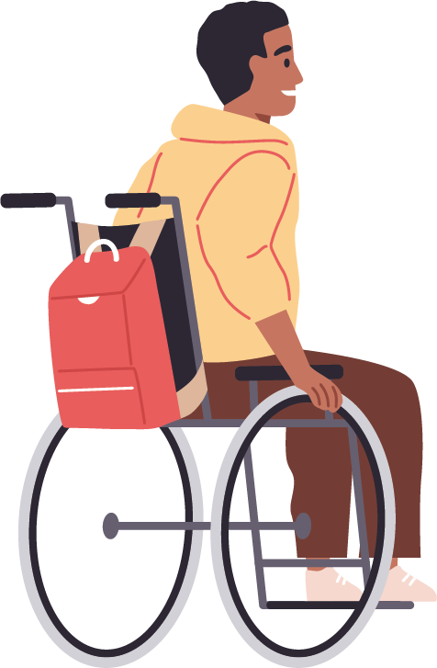

Slide 6


Dependence on Others’ Availability

Slide 7
Dependence on Others’ Availability

Slide 8

Missed Opportunities

Slide 9
Meet James
A young man who battles physical challenges daily
Missed Opportunities

Slide 10

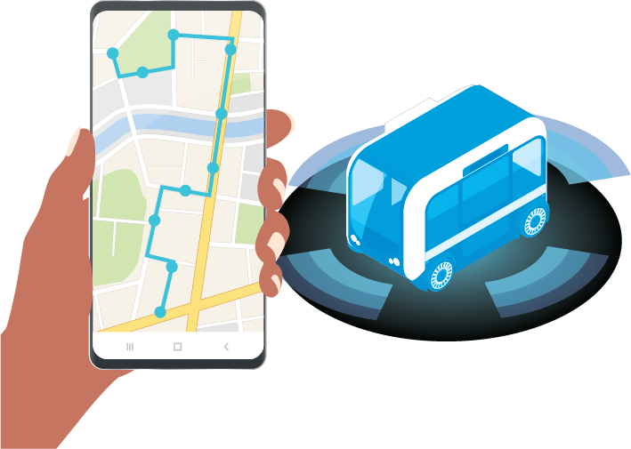
Meet James
A young man who battles physical challenges daily
Independence

Slide 11

Meet James
A young man who battles physical challenges daily

Slide 12

Social
Education
Work

Slide 13
Meet James
A young man who battles physical challenges daily
Social
Education
Work

Slide 14
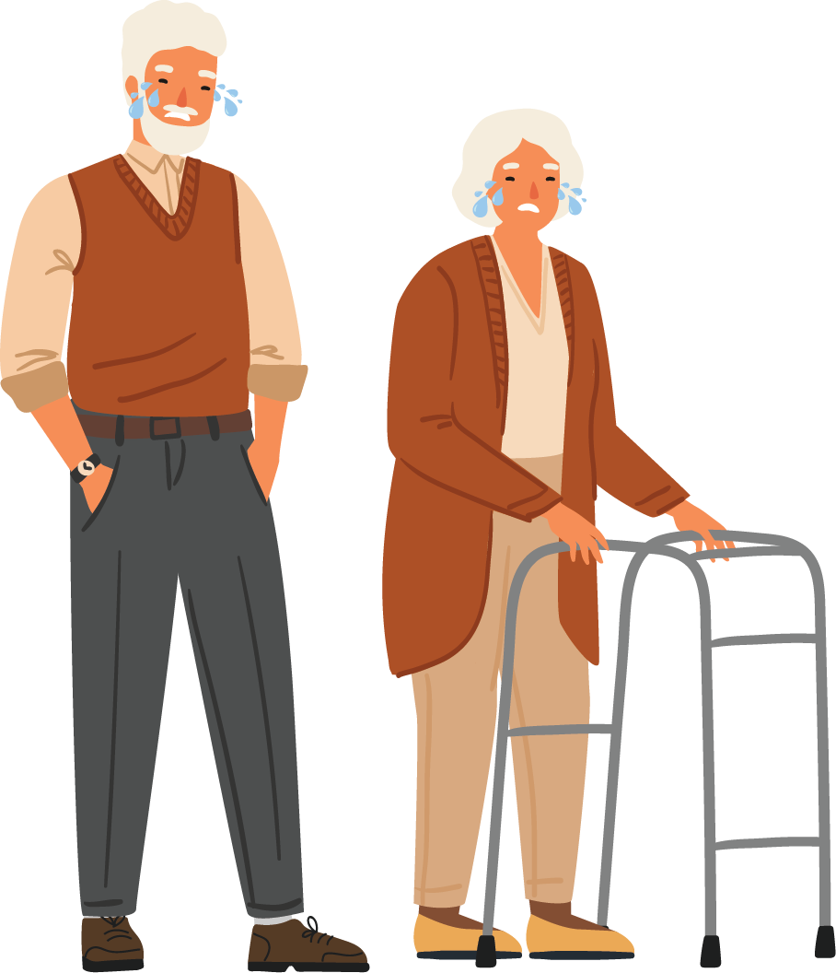

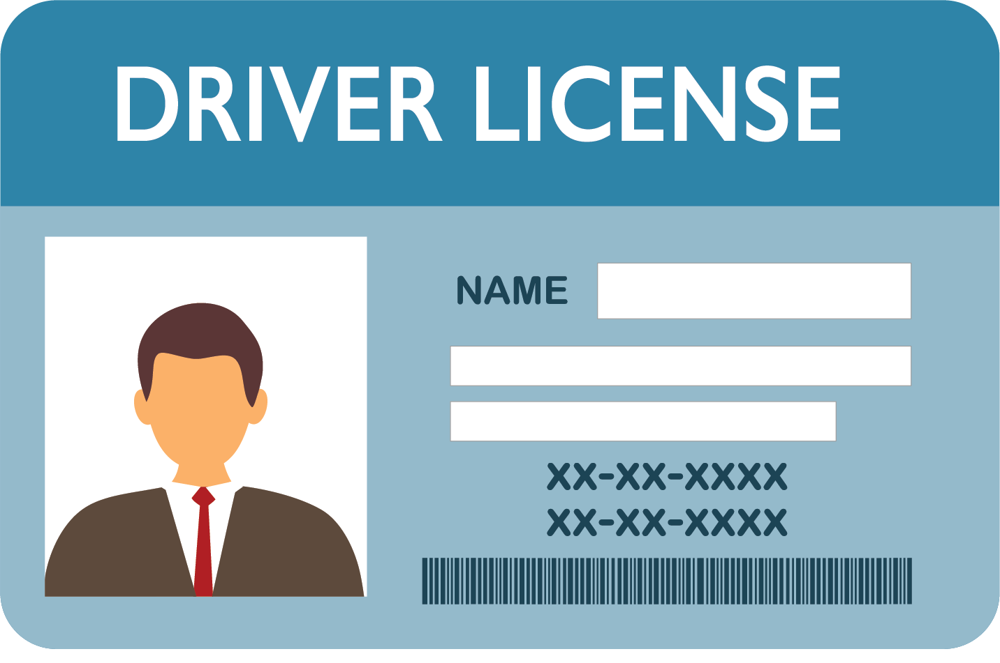

Slide 15


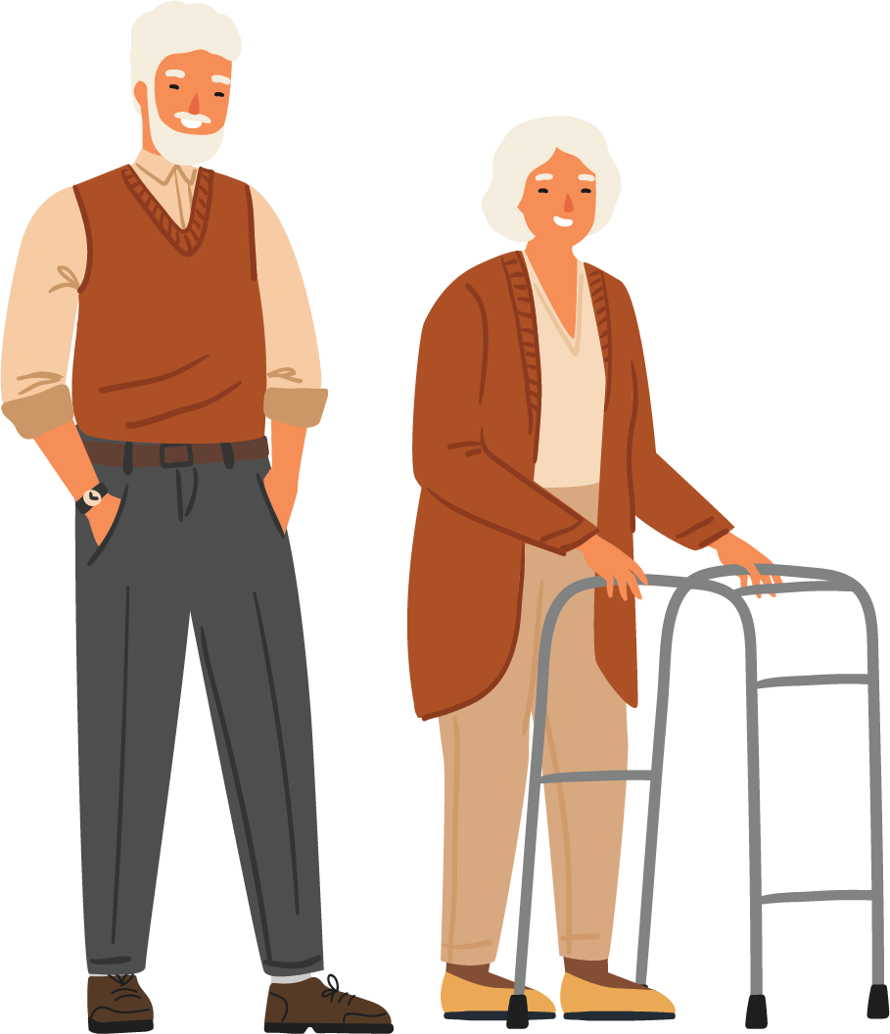


Slide 16





Slide 17
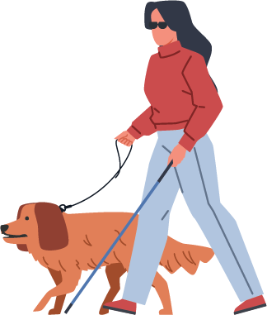


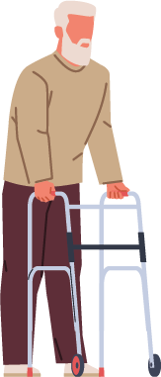

Research Question
To what extend do autonomous vehicles change travel and activity frequency of transport disadvantaged people?
Transport Disadvantaged
People with Disabilities
Older Adults
Others Non-drivers
Importance
Infrastructure Readiness
Policy Advocacy
Market Insights for AVs Manufacturers

Slide 18

What are Autonomous Vehicles?
Autonomous Public Transport (APT)
Autonomous vehicles
Capable of independently and self-sufficiently performing all driving functions in any environment
SAE Level 5
Integration into Transportation System
Private
Shared
Public transport
Private Autonomous Vehicles (PAVs)
Shared Autonomous Vehicles (SAVs)

Slide 19
Quick Stats Snapshot
According to Disability, Ageing, and Carer Survey 2022 (ABS, 2022), among 25.6 million Australians,
5.5 million has disability
4.4 million is older people (≥65 years)
Increase in Older People
52% increase in the number of older people between 2009 and 2022

Slide 20
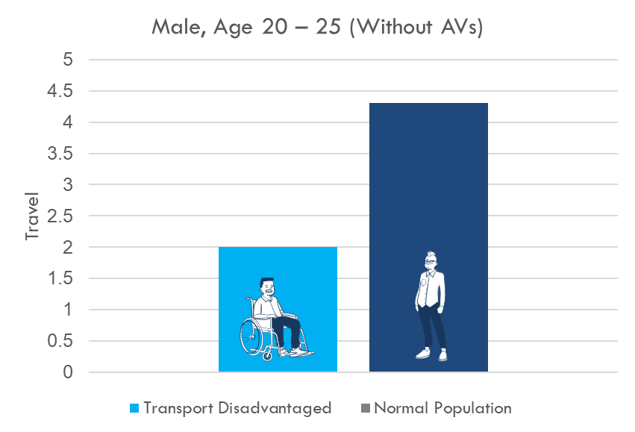
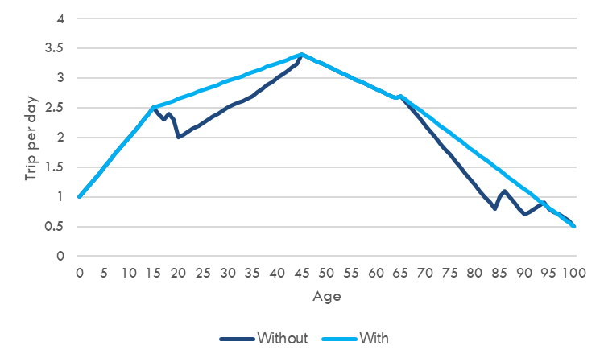
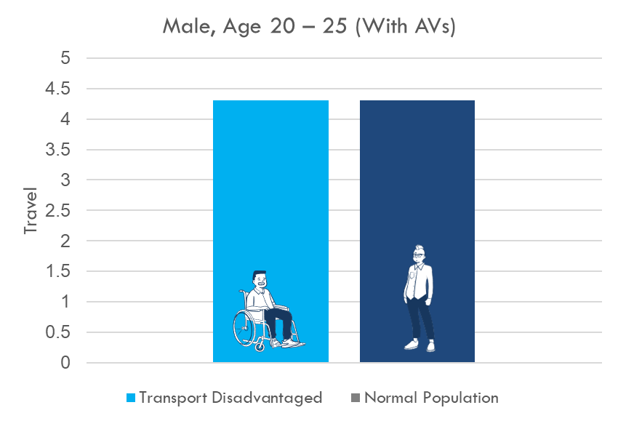
Literature Review
Summary of Literature Review
14% increase in annual vehicle mile travel (Harper et al., 2016)
2 – 10% increase in overall vehicle travel (Wadud et al., 2016)
4.14 % increase in daily trips (Truong et al., 2017)
Research Gap
Handful of studies
Rely on strong assumptions
Need to control socio-economic factors such as income, work status, education levels, travel attitude
Lack of Qualitative Evidence
Increased in trip rate due to AVs

Slide 21
Methodology
Quantitative Research
To quantify the extent to which AVs influence travel and activity frequency among transport-disadvantaged peoples
Data Collection: Sydney Household Travel Survey Data
Data Analysis: Propensity matching score
Qualitative Research
To explore perceptions of transport-disadvantaged individuals regarding AVs as a solution to their mobility barriers,
To prompt anticipated changes in their travel and activity pattern
Data Collection: Focus group
Data Analysis: Thematic analysis
Propensity matching score
Treatment Group
Controlled Group
Impact of Treatment on Trip and Activity Frequency
−
=

Slide 22
Current Progress
Sydney Household Travel Survey Data
Propensity Matching Score
Results
Quantitative Research
Quantitative Research
Ethic
Focus Group
Thematic Analysis
Results
Qualitative Research
Qualitative Research

Slide 23
Thank you for your time
Comments & Questions
Name: Arkar Than Win
Email: arkar.thanwin@sydney.edu.au

